Slide 1
Trigonometry – The Cosine Ratio
EQ: What is the cosine ratio and how can I apply it to right angled triangle?

Slide 2
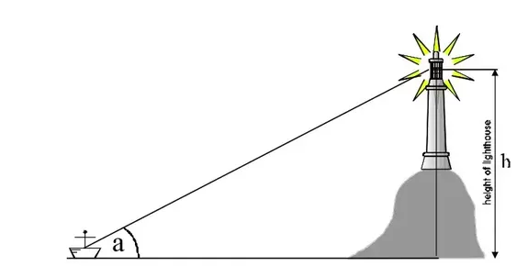
24
7
30
Trigonometry
Date:
EQ: What is the cosine ratio and how can I apply it to right angled triangle?
Real life applications of trigonometry
Why use Trig?
Shipping companies use trigonometry to navigate the seas.

Slide 3



Slide 4

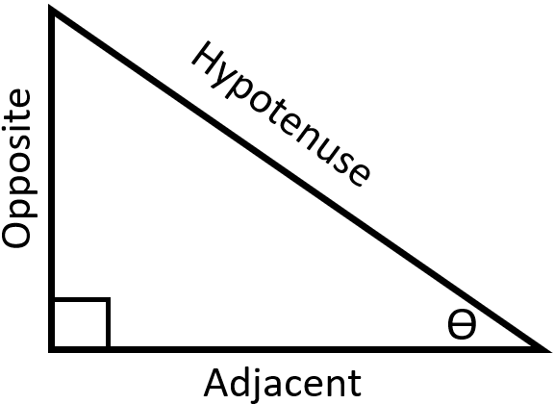

24
7
30
Trigonometry
Date:
EQ: What is the sine ratio and how can I apply it to right angled triangle?
Adjacent side
What is the Cos Ratio?
Hypotenuse side
Cosine of angle
This is generally shortened to
$$cosθ=\frac{Adj}{Hyp}$$

Slide 5
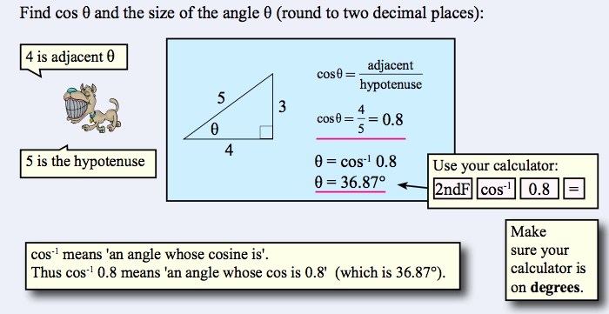
24
7
30
Trigonometry
Date:
EQ: What is the cosine ratio and how can I apply it to right angled triangle?
What is the Cos Ratio and now how do I use it?

Slide 6
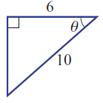
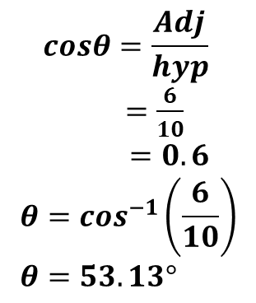
24
7
30
Trigonometry
Date:
EQ: What is the cosine ratio and how can I apply it to right angled triangle?
2nd example
For the example below find the size of the angle θ
What is the Cos Ratio and now how do I use it?
Adj
$$cosθ=\frac{Adj}{hyp}$$
$=\frac{6}{10}$
$$=0.6 \\ θ=\cos^{−1}\left(\frac{6}{10}\right) \\ θ=53.13°$$
Angle θ
This is θ = Shift or 2ndF cos⁻¹ (6/10)
Hyp
Note: we still use (6/10) instead of 0.6 because even though 0.6 is exact it is better to keep to a pattern, some fractions (as we have seen) will give approximations when left as a decimal.

Slide 7
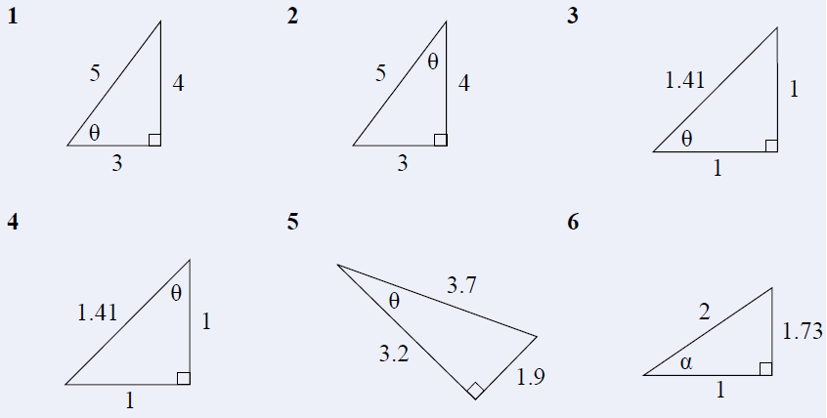
Now complete exercise 17.4 page 233 in the Dwyer Textbook Q1-6, see below and the worksheet 4a Trig – Cos ratio for finding an angle.
Please draw and label each triangle from the text to your Interactive Notebook.

Slide 8
Answers to Ex 17.4

Slide 9
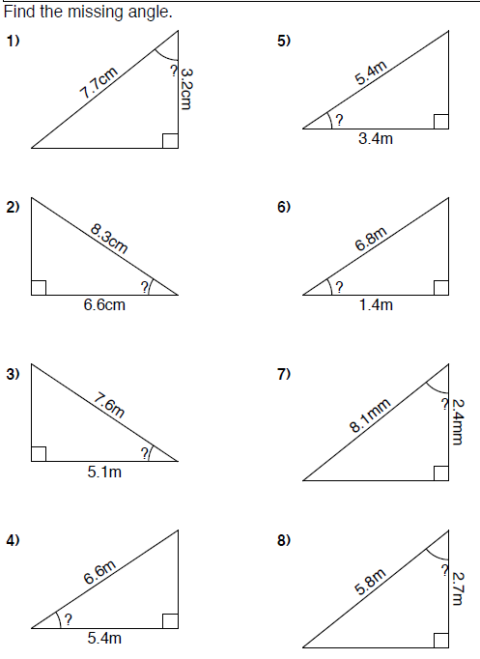

Slide 10
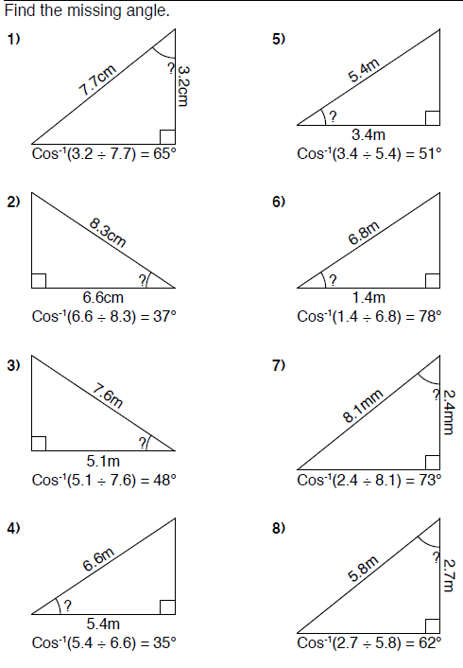
Answers

